Slide 1

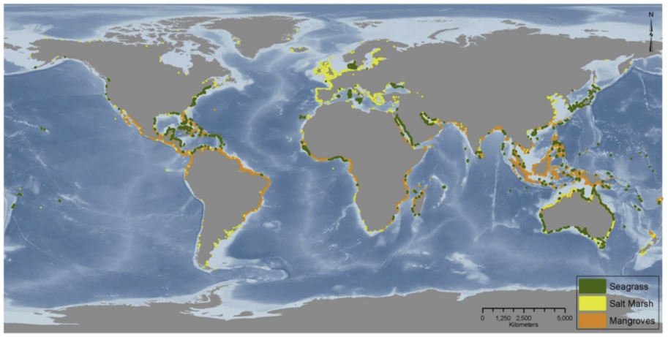
“Blue” Carbon Monitoring System
Linking Satellite and Soil Data to Validate Coastal Wetland 'Blue Carbon' Inventories: Upscaled Support for Developing MRV and REDD+ Protocols (October 2014-17)
Lead PI: Lisamarie Windham-Myers (18 Science PIs, all but 1 PhD)
Federal
USGS Brian Bergamaschi
Kristin Byrd
Judith Drexler
Kevin Kroeger
John Takekawa
Isa Woo
NOAA-NERR Matt Ferner
Smithsonian Pat Megonigal
Don Weller
Lisa Schile
NASA-JPL Marc Simard
Non Federal
U. South Carolina Jim Morris
U. Maryland/NOAA Ariana Sutton-Grier
U. San Francisco John Callaway
Florida Intl. U. Tiffany Troxler
Texas A&M U. Rusty Feagin
Independent Stephen Crooks
Notes:
Thank you for supporting our project
This is a dreamteam of colleagues, 18 PIs, federal/academic/consulting, who have worked together at local, national and international scales to document carbon fluxes in tidal wetlands
This is finally the opportunity to do a “price of precision” analysis and test different approaches for combining satellite and field-based data sets to better constrain C fluxes.
We’ll be working on a verified protocol, focusing on marshes and mangroves in this thin coastal fringe which have been accreting C for the past 8000 years as SLR has risen about 10m. So deep deposits, and high rates of burial, actually 25% of total ocean burial annually.

Slide 2
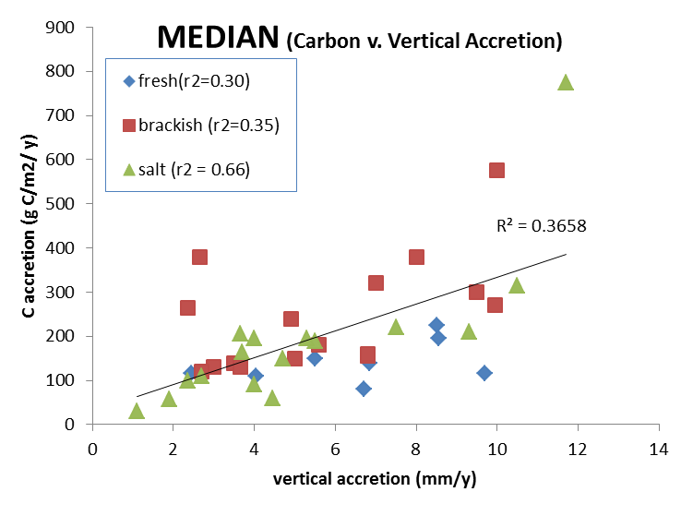
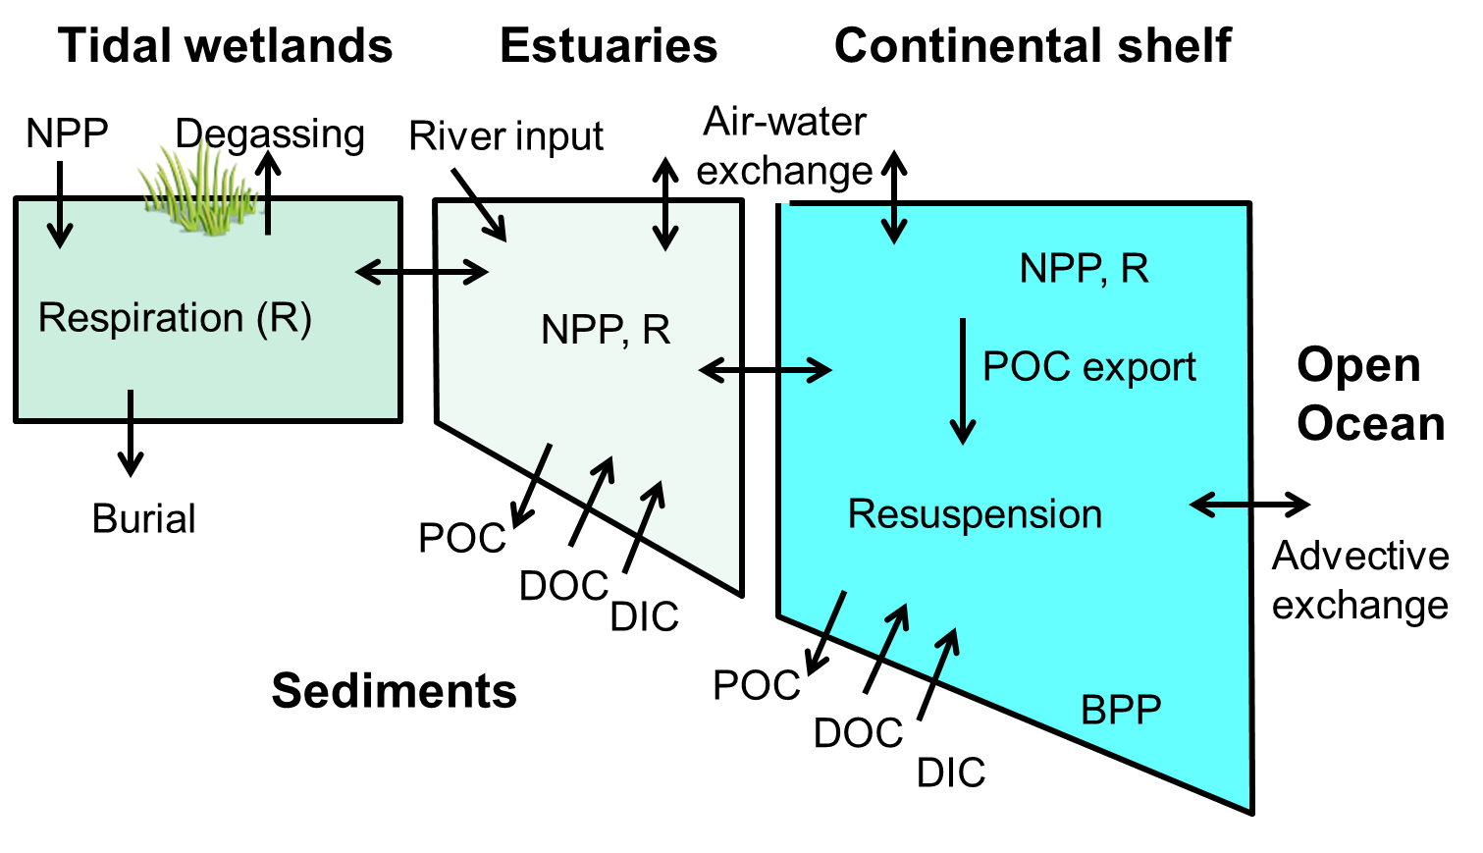
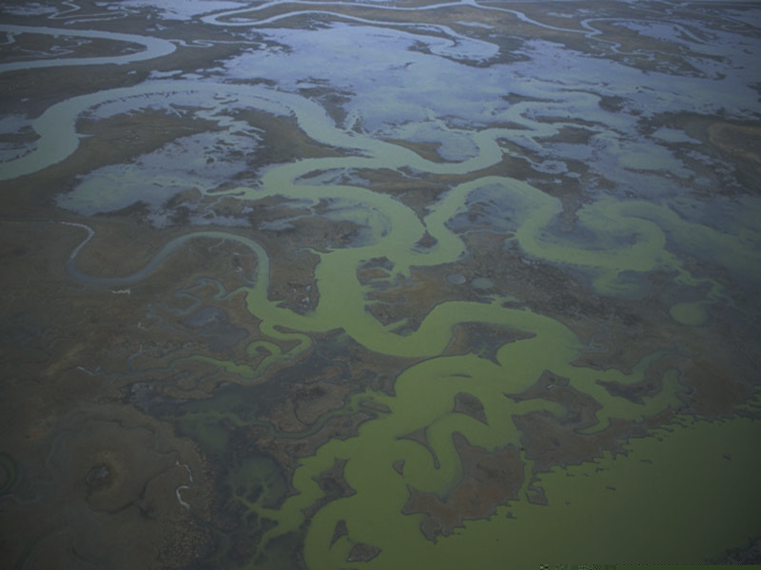
“Blue” Carbon Monitoring System
Can coastal LULC data be used for national GHG inventory?
(IPCC, stock change from 1990 to current)
Can we reduce uncertainty by refining wetland categories?
(vegetation type, biomass, elevation, salinity, sediment)
Notes:
Those rates of burial however are variable.
Here on the y axis, you can see a range from about 80 to 800 g C m2 y , most points clustered here in the 100-200 range.
This is mostly a response to vertical accretion, so growing with sea level rise, about 2-3 mm/y globally.
So this longterm burial is just one term in total coastal C accounting at the land margin, but from a greenhouse gas perspective, it is the primary flux that makes “blue carbon” attractive.
Another advantage, is that when sulfate is abundant (such as in seawater), methane production is low.
On the other side, there are pedagrams of carbon in those deep peat deposits which could be released quickly if degraded.
So these wetlands can be a large sink or a large source depending on what we do.
So for developing a MRV protocol, our goal is to start simple with previously mapped LULC and soil data for stock changes over say 20 years, and then go further with more refined data in specific sites to determine the degree to which additional environmental attributes help reduce uncertainty in the C burial flux rate.

Slide 3
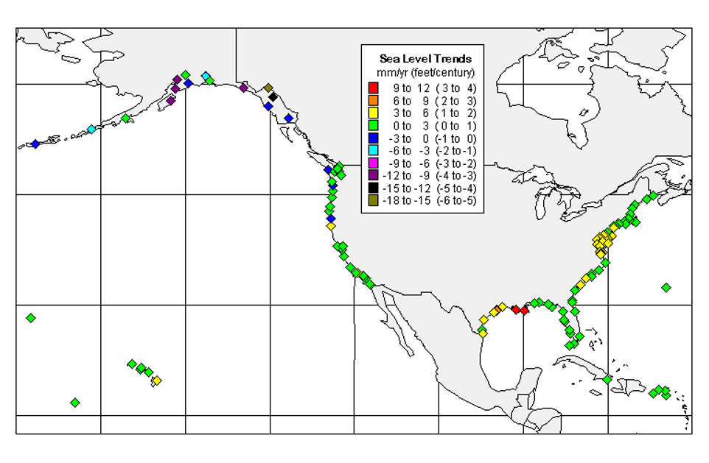
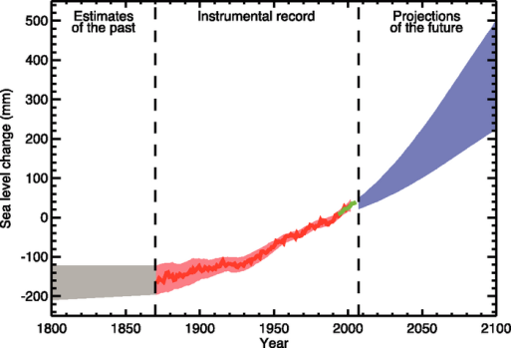
“Blue” Carbon Monitoring System
Product 1: National Scale stock-based 30m resolution C pool maps (1992-2011) via NOAA’s C-CAP (NLCD) linked with regional SLR and SSURGO 1m soil data
High
14 mm/y
Satellite
3.2 mm/y
Avg
8 mm/y
0.5 mm/y
Tide gauge
1.7 mm/y
Notes:
So our first product will be national in scale.
The NOAA C-CAP datasets (which I’ll show an example of later) have been matched with USDA SSURGO data already within the USGS so we can calculate 1m deep stocks throughout the country.
The RATE of C accretion or loss, however, needs to track changes in elevation so we’ll add an elevation component both through
DEMs, for big elevation differences
And through
Accretion, using networks of tidegauges or
Here are sea level trend data from NOAA gauges across US and you can see they are mostly green, so in the 0-3mm/y range.
But relative SLR is local and takes into account land subsidence as well
Two regional hotspots are the gulf, where RSLR is as high as 9mm/y, and the northeast around 5mm/y.

Slide 4
“Blue” Carbon Monitoring System
Product 1: National Scale stock-based 30m resolution C pool maps (1992-2011) via NOAA’s C-CAP (NLCD) linked with regional SLR and SSURGO 1m soil data
Product 2: Sentinel Site stock-based
and process-based maps, where
Field and remote sensing data availability (abundance and quality)
Within-site range of tidal wetland categories
  Salinity
  Vegetation types
  Landuse (degradation, restoration)
Between-site range of climate variables
Notes:
Our second product will be focused on 6 sentinel sites that constrain these major differences in SLR and climate drivers.
We can add more attributes in these focal sites, where we have abundant information, including corrected LIDAR and validated biomass data as calculated from spectral or RADAR measurements
We will see if these extra attributes, such as salinity, vegetation category, elevation, generate a better match to the stock data and rates of annual C burial calculated from soil cores.
Our “ground truth” data set for validating these stocks and rates will be date-controlled soil cores.

Slide 5
“Blue” Carbon Monitoring System
Product 1: National Scale stock-based 30m resolution C pool maps (1992-2011) via NOAA’s C-CAP (NLCD) linked with regional SLR and SSURGO 1m soil data
Product 2: Sentinel Site stock-based
and process-based maps, where
Field and remote sensing data availability (abundance and quality)
Within-site range of tidal wetland categories
  Salinity
  Vegetation types
  Landuse (degradation, restoration)
Between-site range of climate variables
Product 3: Price of Precision Error Analysis (30m v 250m, Tier 1,2,3, Algorithms)
Notes:
Finally, we will use these simple and refined approaches to determine how much data is needed, and at what scale, to generate acceptable estimates for site level and regional level C burial.
We will also test different algorithms and approaches for biomass estimation.
This uncertainty analysis is the primary product that will let us provide feedback to the UNFCCC SBSTA on different inventory approaches for soil accretion, live and dead biomass, and methane and nitrous oxide default values.

Slide 6
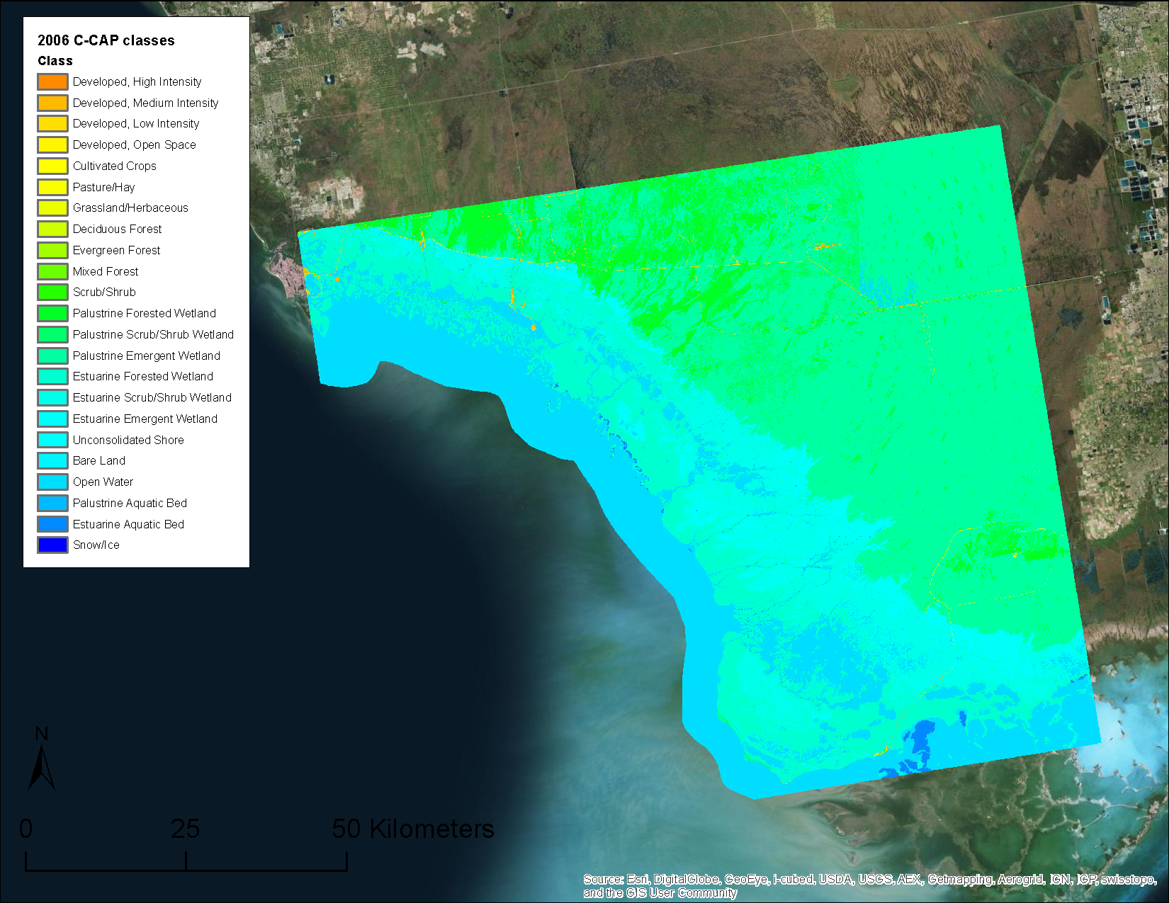
“Blue” Carbon Monitoring System
 | C-CAP | C-CAP | SSURGO | IPCC Default | USFWS | RS Data | + field
Date | Hydrology | Vegetation | Soil C stock (T) | Biomass C stock (T) | Salinity | Biomass | calibrate
1992 | Palustrine | Forested | 30 | 4 | Fresh
2011 | Estuarine | Emergent | 32 | 2 | Brackish
Example: Shark River Slough, Everglades, Florida
Notes:
Heres an example from the Shark River Slough, with the 2006 classified C-CAP categories.
The Ameriflux Mangrove station for reference, and this is a roughly 8000 km2 area.
The greens are palustrine (freshwater) and the blues are estuarine,
We’ll be taking these pixels and characterizing their C stocks in 1992 and in 2011.
The difference in stock between those years, can be calculated.
So in this scenario for example, we have salinity intrusion into a cypress swamp, there will be continued accretion but also a drop in live biomass.
Overall in this case, there would be no net change in C stock.
As finer categorization is added (including the category freshwater tidal by integrating with USFWS NWI) , we will revise the soil and plant C stocks and see how these more refined data influence specific pixels and regional estimates.
Its about 5% Estuarine Emergent, 24% Estuarine Forest (Mangrove), and 50% all Palustrine, which includes freshwater tidal.

Slide 7
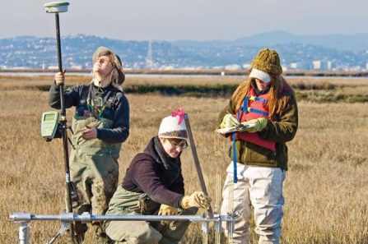
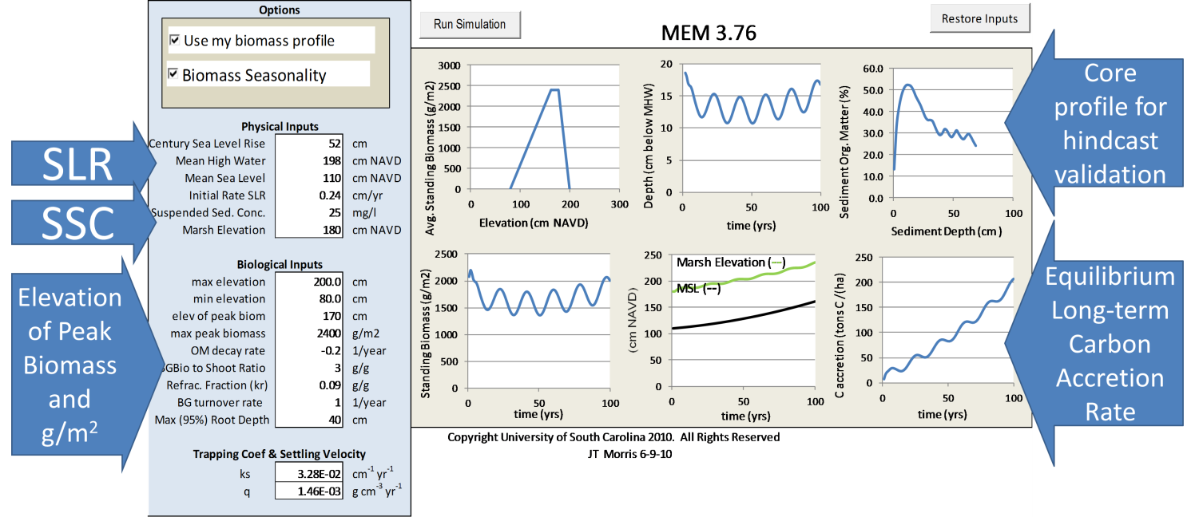
“Blue” Carbon Monitoring System
From past and present, project future
Marsh Equilibrium Model: mechanistic, annual cohort, 1D accretion
Once calibrated, relative elevation is used to estimate cumulative accretion, water depth, flooding frequency, aboveground and belowground biomass, and carbon stored.
Notes:
Field data is essential to validating the GIS model as well as calibrating a process-based model.
We’re using a robust model, with the most important inputs being good tidal frame context, vegetation distribution, and a deep corefor calibrating the model in a hindcast, This panel organic matter distribution with depth.
Several of the PIs have been testing the model performance with remotely sensed inputs, with good results.
And a developing methane module can run off these projections, and be verified in our sentinel sites.

Slide 8
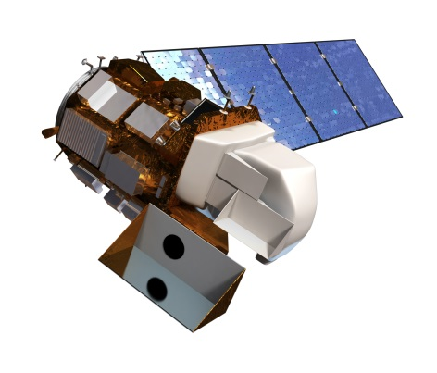

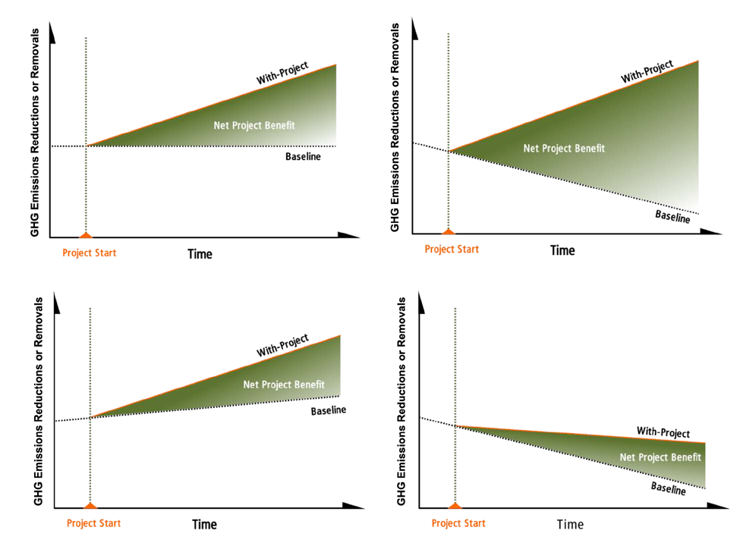
“Blue” Carbon Monitoring System
Linking Satellite and Soil Data to Validate Coastal Wetland 'Blue Carbon' Inventories: Upscaled Support for Developing MRV and REDD+ Protocols
Goal:
IPCC National Greenhouse Gas Inventory
Need demonstration of approaches for SBSTA, 2017
REDD+ development (international)
Need protocol for stock-based soil C
Carbon market (voluntary and regulatory)
Need projections of baseline and activity budgets
=
verifiable protocol to support federal, international, and market incentives
Example wedges of GHG benefits
Notes:
So with satellite data coupled to all the new progress in salt marsh C modeling we hope to generate a verifiable protocol that is relevant to policy makers.
That includes helping the EPA address the new Wetlands Supplement Guidelines for the National Greenhouse Gas Inventory
Also, determining data requirements for REDD+ inclusion for international accounting, based on stock based soil C assessments.
Finally, carbon crediting systems, which are based on projected effects of an activity vs. baseline conditions over time.
So this coupling of remotely sensed inputs, mapped products such as soil and USFWS wetland categories, and detailed site information for validation has many uses.
Our goal is to determine how much more exact our C burial estimates can be as finer grained data is integrated with satellite-based LULC datasets, for these different policy needs.

